Slide 1
Next Steps @ UM

Slide 2
Discussion topics
The Michigan Difference & Affordability
Cost & Budgeting
Navigating Your Student E-bill
Special Circumstances
Best Practices
Important Dates
Frequently Asked Questions

Slide 3
The Michigan Difference & affordability
The University of Michigan:
Has the most financial aid of any state school in Michigan & in the Big Ten Conference: 71% of in-state undergraduates receive some form of financial aid
Meets the full demonstrated institutional financial need of eligible resident undergraduates.
Awarded $282.5 million in grants and scholarships to undergraduate students
Has four times the jobs for the number of students who are offered Work-Study
Has increased institutional grants 50% in the last five years
$282.5
MILLION

Slide 4
Cost & budgeting
Direct Costs
Paid DIRECTLY to the university (billed twice per year):
Tuition & fees
Housing & meals
Indirect Costs
Paid to others and can include:
Books & supplies
Personal & miscellaneous items
Transportation

Slide 5
Cost & budgeting
U-M Cost of Attendance
 | In-State | Out-of-State
Tuition & Fees | $ 16,178.38 | $ 53,232.38
Housing and Meals | $ 12,592.00 | $ 12,592.00
Books & Supplies | $ 1,048.00 | $ 1,048.00
Personal/Misc. | $ 2,454.00 | $ 2,454.00
TOTAL | * $ 32,272.38 | * $ 69,326.38
* This is the maximum amount of financial aid you can receive.

Slide 6
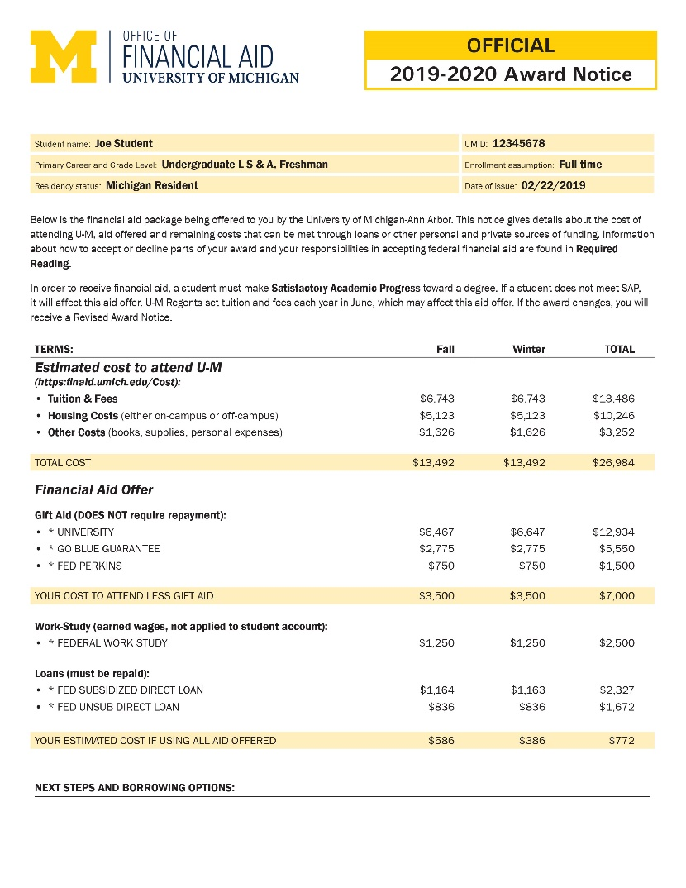
Cost & budgeting
Sample Financial Aid Notice
2020-2021 Award Notice
02/22/2020
02/22/2020
Notes:
Update the years on the images to be 2020-2021 or 2020 (if it is a single date)

Slide 7
Cost & budgeting
Sample Financial Aid Notice
2020-2021 Award Notice
02/22/2020
Fall 2020
Winter 2021
Fall 2020
Winter 2021

Slide 8
Cost & budgeting
Sample Financial Aid Notice
2020-2021 Award Notice
02/22/2020

Slide 9
Cost & budgeting
Sample Financial Aid Notice
2020-2021 Award Notice
02/22/2020
Fall 2020
Winter 2021

Slide 10
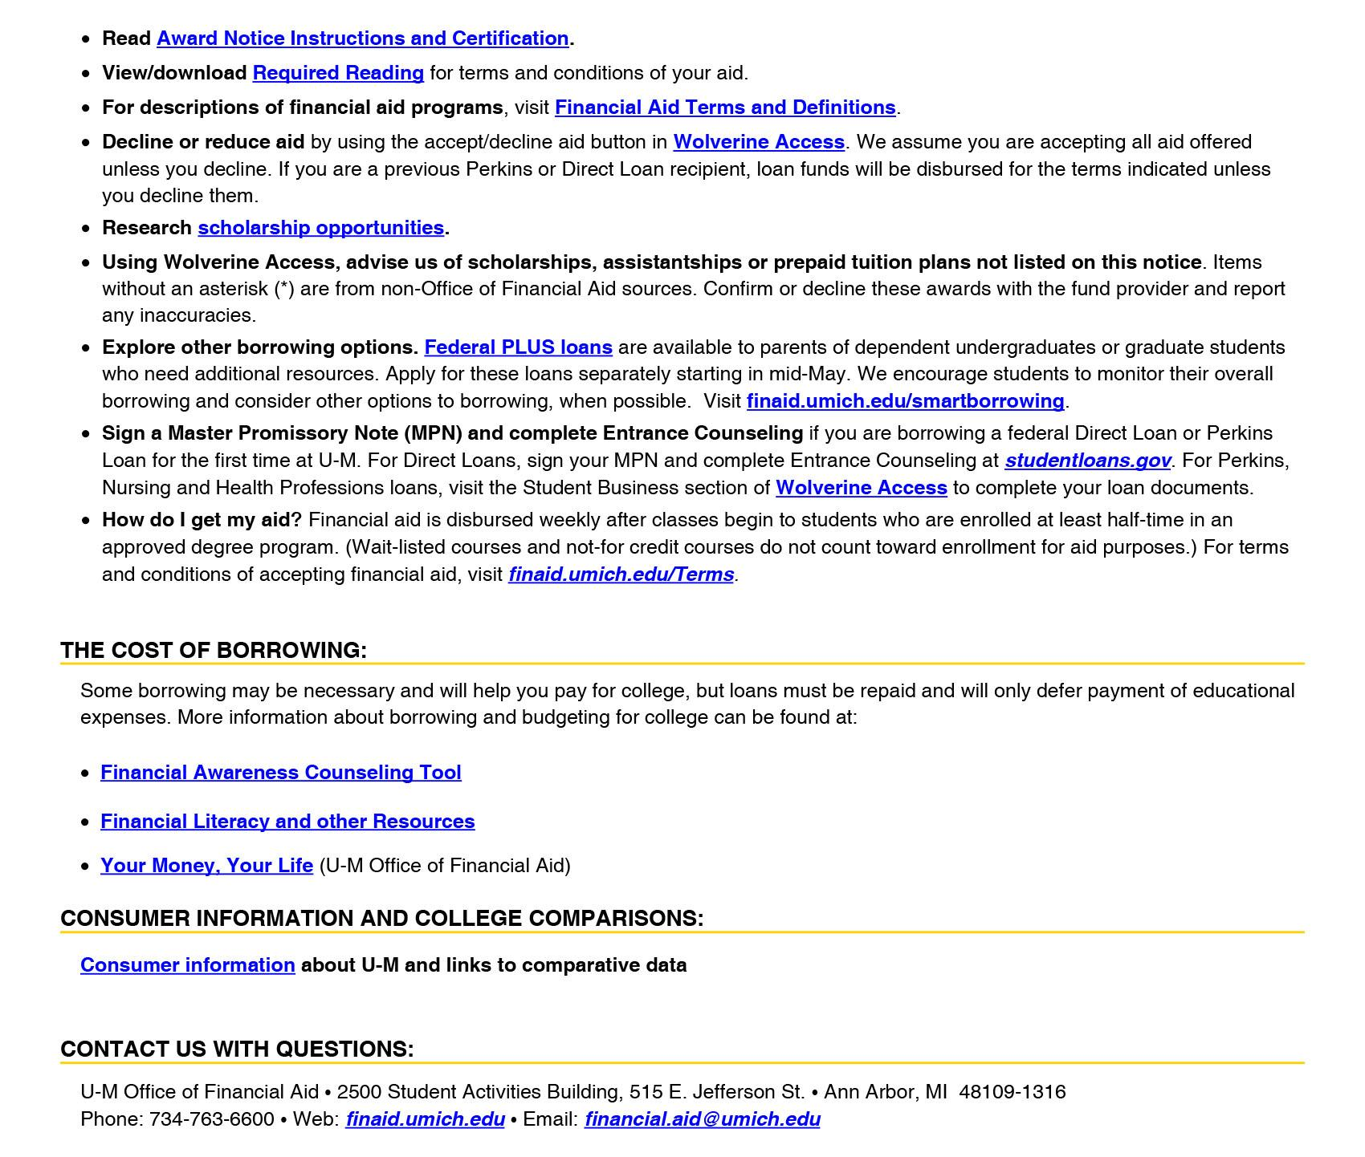
Cost & budgeting
Sample Financial Aid Notice
2020-2021 Award Notice
02/22/2020
Fall 2020
Winter 2021

Slide 11
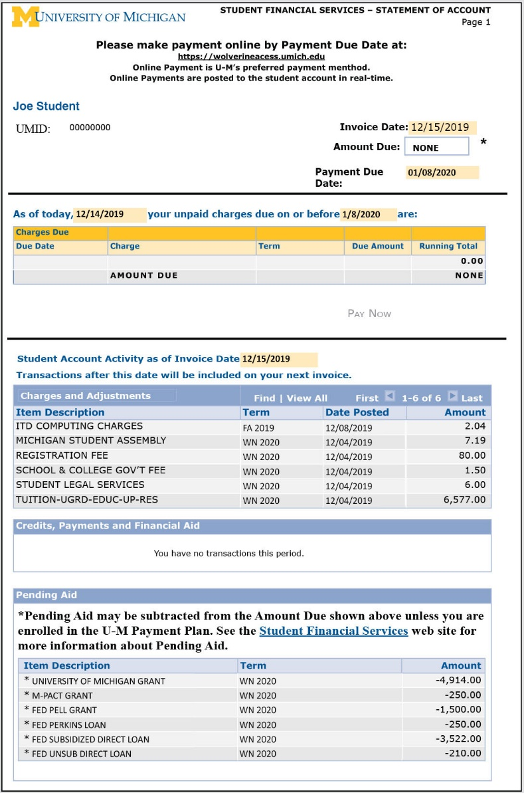
Navigating your student e-bill
What does it look like?
How do I read it?
What do I pay?
12/15/2020
01/05/2021
12/14/2020
01/05/2021
12/15/2020
01/05/2021
12/14/2020
01/05/2021

Slide 12
Navigating your student e-bill
What does it look like?
How do I read it?
What do I pay?
12/15/2020
01/05/2021
12/14/2020
01/05/2021
12/15/2020

Slide 13
Navigating your student e-bill
What does it look like?
How do I read it?
What do I pay?
12/15/2020
01/05/2021
12/14/2020
01/05/2021

Slide 14
Special circumstances
Circumstance:
Change in employment
Death
Change in parents’ marital status
One-time significant benefit;
High, out-of-pocket medical expenses, etc.
Actions:
Complete the initial financial aid process
Report circumstance to the Office of Financial Aid by phone, email, or mail
All special circumstances are reviewed, and a FINAL decision is made*
* Decisions cannot be appealed to U.S. Dept. of Education

Slide 15
Best practices
Be sure to:
Consider enrolling in a payment plan
Review Satisfactory Academic Progress requirements
Talk to experts on campus
Apply for scholarships each year
Only borrow what you need
Check and respond promptly to email and all requests
Check website and review Financial Aid Newsletter

Slide 16
Important Dates
Submit FAFSA & Profile by March 31
Additional documents may be required; submit as soon as possible
Notes:
*Special Note: For CSS Profile, students from separated/divorced households, the Household B application is also due by March 31.

Slide 17
Frequently asked questions
Why don’t I have a financial aid package yet?
We may need additional documents.
Check your emails and Wolverine Access account for requested documents.
OR
We may need your Social Security number.
Your social security number is needed to import your financial aid application. Without it, we cannot link your applications in our system.

Slide 18
Frequently asked questions
What is a Tax Return Transcript?
The IRS tax return transcript is the official tax document used for verification and must be requested through the IRS website at www.irs.gov/individuals/get-transcript. We use 2020 tax information for the 2022-2023 FAFSA and CSS Profile.

Slide 19
Frequently asked questions
What if my financial circumstances are significantly different than what was reported for 2020?
We must use the 2020 tax year information that was requested.
However, once we have completed our initial review process, you may submit documentation for us to re-evaluate your eligibility based on your current situation.
Not all outcomes are guaranteed and may not create a huge difference in financial aid eligibility, but our office will help you to understand based on your individual situation.

Slide 20
Frequently asked questions
Are there deadlines for financial aid?
Yes. March 31 is our deadline to submit the FAFSA and CSS Profile. Remember, additional documents may be requested, such as W-2 forms, tax return transcript, questionnaires, etc.
Note: scholarships that we require applications will have separate deadlines.

Slide 21
Frequently asked questions
Do I have to complete the Free Application for Federal Student Aid and the CSS Profile?
No. However, if you’re seeking assistance to help pay for college expenses, these two applications are the initial steps to starting that process.
Is there a way notifications can be sent to me, the parent, and my student?
Yes. You can set up a Friends and Family Account to view and receive financial aid notifications.

Slide 22
Frequently asked questions
Are Federal Work-Study funds applied to my student bill?
No. Work-Study is an award that allows you to earn a paycheck from hours worked; does not apply money to your student billing account.
Students are paid bi-weekly, and receive a paycheck. Direct Deposit is strongly encouraged.
You can then use this money for college costs.

Slide 23
Frequently asked questions
How do I apply for scholarships?
Your admissions application can also serve as your scholarship application for the school or college that you applied to.
We encourage students to complete the “My Scholarship Profile” through Wolverine Access.
Admitted students are encouraged to seek scholarships from all sources (i.e. private, state, institutional, etc.), and will have opportunities to apply for scholarships throughout their college career.
Details: finaid.umich.edu/scholarships-at-u-m

Slide 24
Your turn…questions?

Slide 25
Please contact us if you have any further questions
Email us
financial.aid@umich.edu
University of Michigan Office of Financial Aid
finaid.umich.edu
Federal Student Aid
studentaid.gov
Michigan Office of Scholarships and Grants
1-888-4-GRANTS
michigan.gov/mistudentaid
The information presented is based on current circumstances and is subject to change. Please refer to specific schools/institutions for additional information.

